Slide 1


ITM 540
Data Networks
The Network Layer
Layer 3
The IP Layer
Professor: Carol Davids
Email: davids@iit.edu
Carol Davids © 2014

Slide 2
Reading Assignments
Forouzan :
Part 4: Introduction
  Host to host delivery: Internetworking, Addressing, and Routing
  Network Layer Protocols: ARP, IPv4, ICMP, IPv6, ICMPv6
  IP datagram fields and their functions
Carol Davids © 2014

Slide 3
Reading Assignments
Forouzan Chapters:
Chapter 19: IP addressing
Chapter 20: IP datagram fields and the functions they support
Chapter 21: Other layer 3 protocols that support IP
Chapter 22: Routing
Carol Davids © 2014

Slide 4
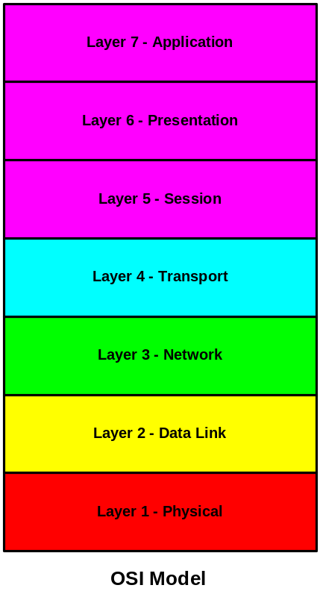
OSI Model
The International Organization for Standards (ISO) developed the Reference Model for Open Systems Interconnection in the late 1970’s.
The Reference model is referred to as the OSI 7-layer protocol stack gives us a way to logically separate the different communications functions that the network provides.
Layer 1 - Physical Layer - defines the physical characteristics of 1’s and 0’s, how to distinguish them from noise, and how to put them into frames to send them across the network.
Layer 2 - Data Link Layer - defines how to create an error-free connection between two processes in different pieces of equipment on the same local network.
Layer 3 - Network Layer - defines how to perform routing, addressing and fragmentation over links created at layer2.
Carol Davids © 2014

Slide 5
OSI Model
Layer 4 - Transport Layer - Enables reliable end-system to end-system communication across different networks.
Layer 5 - Session Layer - Controls the dialog between applications in the end-systems.
Layer 6 - Presentation Layer - Resolves differences in format and data presentation.
Layer 7 - Application Layer - Provides a user interface and supports distributed applications
Carol Davids © 2014

Slide 6
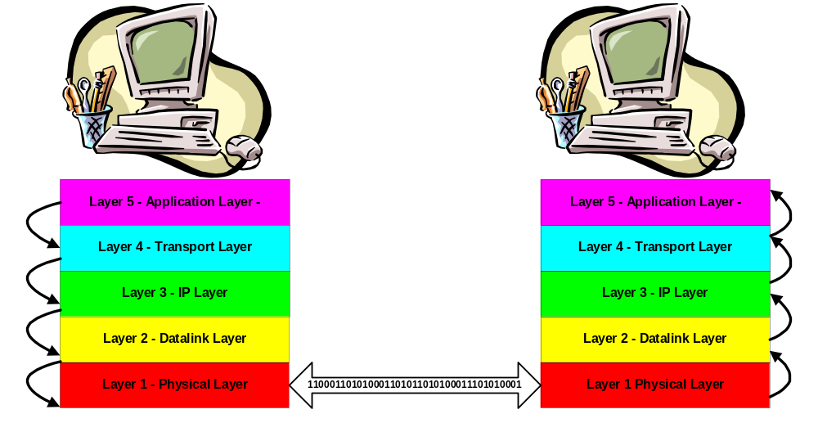
Layered communication
Applications appear to talk directly to each other.
Carol Davids © 2014

Slide 7
Network Layer Functions
The function of the network layer is to link physical networks together.
The network layer hides the details of the physical network.
Carol Davids © 2014
Notes:
Sandwitch diagram –
2 docsis header
1 cable

Slide 8
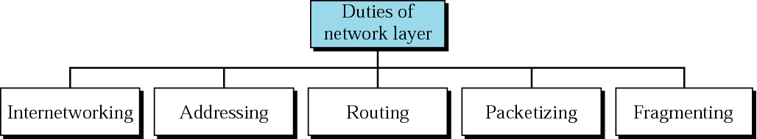
Network Layer Functions
Internetworking
Addressing
Routing
Packetization
Fragmentation
Carol Davids © 2014
Notes:
Ip address ,

Slide 9
Internetworking
Connect LANs and WANs
Carol Davids © 2014

Slide 10
Addressing
Unique network address
Address enables Routing
Address has global (universal) significance
Carol Davids © 2014

Slide 11
Routing
Internet is a mesh
There are many different possible sets of links to connect one host to another
Routers enable the choice of the ‘best’ set of links to take.
Carol Davids © 2014

Slide 12
Packetization
Encapsulate packets of data received from higher layer
Header of the layer 3 datagram contains the destination network address and the source network address
Carol Davids © 2014

Slide 13
Fragmentation
An IP datagram arrives at a router on a certain interface.
The interface was associated with a particular layer 2 that had a particular upper and lower limit on the size of frames it could carry
Carol Davids © 2014

Slide 14
Fragmentation
The router chooses an interface to send the datagram out on.
The new interface faces a different WAN or LAN with a different maximum and minimum Frame size
Carol Davids © 2014

Slide 15
Fragmentation
If the maximum frame size allowable on this new LAN or WAN is smaller than the current size of the datagram, the router needs to fragment the IP Datagram it received
Fragmentation = break the datagram up into smaller datagrams - each with its own layer 3 headers
Carol Davids © 2014

Slide 16
The Internet :
A Network Layer Invention
The Internet has several major backbones made up of high bandwidth point-to-point lines and fast routers.
Regional networks are attached to this backbone.
LANs are attached to the Regional networks.
Carol Davids © 2014

Slide 17
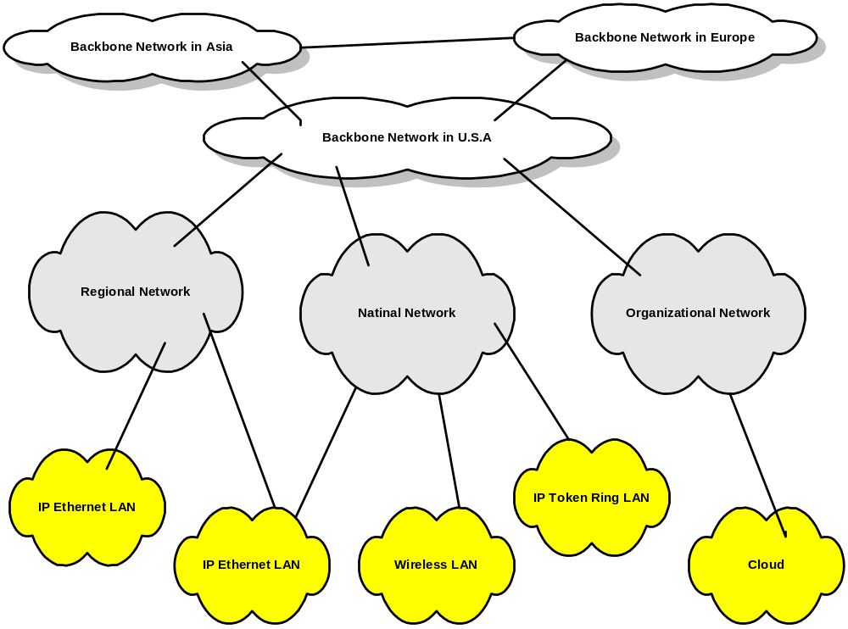
Carol Davids © 2014

Slide 18
Communication on the Internet
On the sending side:
Transport layer breaks the data stream up into layer 4 messages and hands these messages down to the Network layer.
The Network layer packages the data from layer 4 into layer 3 datagrams.
When sending to an Ethernet LAN, the length of the layer 3 datagrams is restricted to 1500 or 1492 bytes so that they can fit into one Ethernet or 802.3 Frame.
Carol Davids © 2014

Slide 19
Communication on the Internet
Datagrams may need to be Fragmented into smaller units to fit into physical networks that limit the size of frames they can transport.
Carol Davids © 2014

Slide 20
Communication on the Internet
On the receiving side:
The Network layer puts all the fragments of the datagram back together to recreate the original datagram.
The Network layer hands the reconstructed datagram up to the Transport layer.
The Transport layer places the datagram in the input queue of the receiving process.
Carol Davids © 2014

Slide 21
Internet Protocol Specifications
IP : RFC 791 published in 1981, and amended in RFCs 950, 919, and 920
IP Requirements for Internet Hosts : RFC 1122 and 1123
IP Requirements for IP Routers: RFC 1812 (IP v4)
Carol Davids © 2014

Slide 22
Internet Protocol
The IP specification deals with two main issues:
  Addressing
  Fragmentation
It specifically is not concerned with creating streams of data.
Carol Davids © 2014

Slide 23
Internet Protocol : RFC 791
“1.2. Scope The internet protocol is specifically limited in scope to provide the functions necessary to deliver a package of bits (an internet datagram) from a source to a destination over an interconnected system of networks.
There are no mechanisms to augment end-to-end data reliability, flow control, sequencing, or other services commonly found in host-to-host protocols.
The internet protocol can capitalize on the services of its supporting networks to provide various types and qualities of service.”
Carol Davids © 2014

Slide 24
IP Protocol
The format of the IP datagram is shown on the next slide.
The fields in this datagram carry information that enables the receiving layer 3 entity to perform its functions:
  Routing
  Fragmentation
Carol Davids © 2014

Slide 25
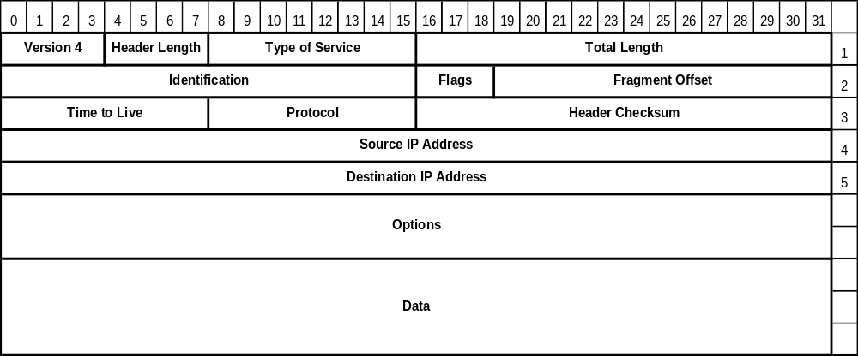
IP Protocol
If no options are used the size of the IP header is 5, 4-byte words = 20 bytes.
HLEN is a 4 bit number – it is the header length, expressed as the number of 4-byte words.
Carol Davids © 2014
Notes:
Ipheader| |
Total length = 2 exp16
======================================
2 exp 4 = header length
====================================

Slide 26
IP Datagram
Carol Davids © 2014

Slide 27
Wireshark Traces
  Frame 87 (87 bytes on wire, 87 bytes captured)
  Ethernet II, Src: 00:a0:c9:82:e8:16, Dst: 00:0b:46:cc:61:e1
  Destination: 00:0b:46:cc:61:e1 (216.47.140.2)
  Source: 00:a0:c9:82:e8:16 (Intel-Hf_82:e8:16)
  Type: IP (0x0800)
  Internet Protocol, Src Addr: 216.47.140.180 (216.47.140.180), Dst Addr: 192.168.123.254 (192.168.123.254)
  Version: 4
  Header length: 20 bytes
  Differentiated Services Field: 0x00 (DSCP 0x00: Default; ECN: 0x00)
  Total Length: 73
  Identification: 0xe2e8 (58088)
  Flags: 0x00
  Fragment offset: 0
  Time to live: 128
  Protocol: UDP (0x11)
  Header checksum: 0xb630 (correct)
  Source: 216.47.140.180 (216.47.140.180)
  Destination: 192.168.123.254 (192.168.123.254)
  User Datagram Protocol, Src Port: 3104 (3104), Dst Port: domain (53)
  Domain Name System (query)
Carol Davids © 2014

Slide 28
Wireshark Traces
  Internet Protocol, Src Addr: 216.47.140.180 (216.47.140.180), Dst Addr: 192.168.123.254 (192.168.123.254)
  Version: 4
  Header length: 20 bytes
  Differentiated Services Field: 0x00 (DSCP 0x00: Default; ECN: 0x00)
  Total Length: 73
  Identification: 0xe2e8 (58088)
  Flags: 0x00
  Fragment offset: 0
  Time to live: 128
  Protocol: UDP (0x11)
  Header checksum: 0xb630 (correct)
  Source: 216.47.140.180 (216.47.140.180)
  Destination: 192.168.123.254 (192.168.123.254)
Carol Davids © 2014
Notes:
Time to live : every process that router use
Header checksum : end to end

Slide 29
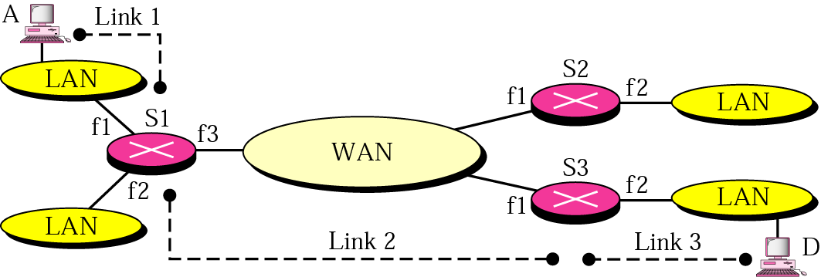
Why the Network Layer
Figure 19.1 illustrates an inter-network where LANs are connected to routers by means of links.
The routers have multiple interfaces, f1, f2, f3.
Carol Davids © 2014

Slide 30
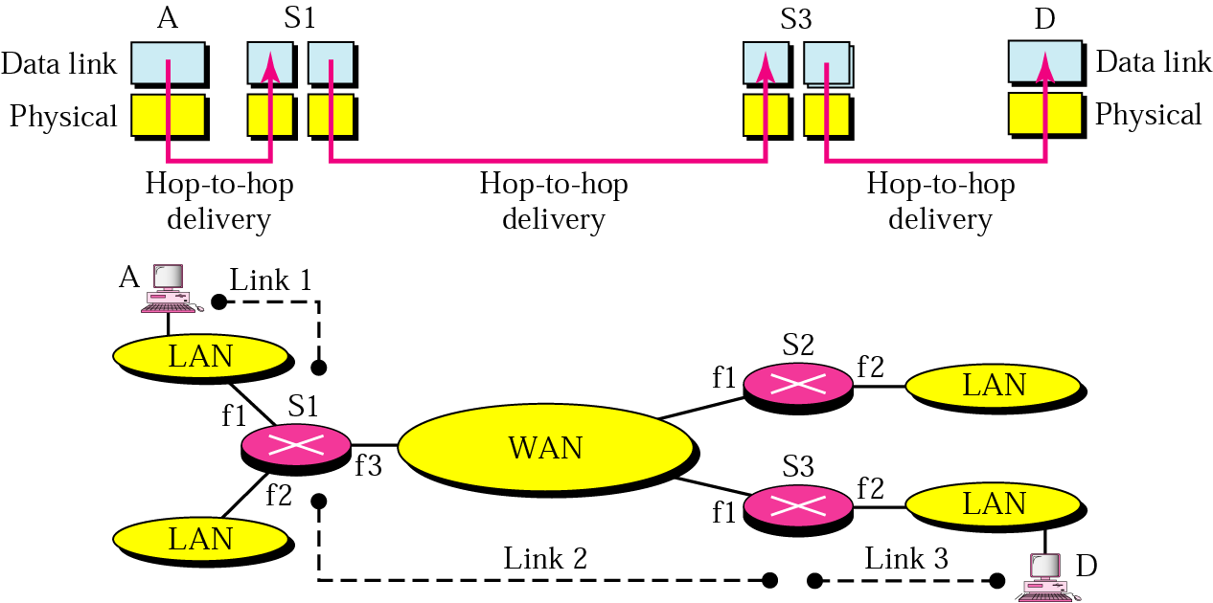
Why the Network Layer
Figure 19.2 is the ‘sandwich’ view of 19.1
Each link associates 2 physical layers and 2 data link layers.
Carol Davids © 2014

Slide 31
Why the Network Layer
Each link has its own interface.
How will S1, S2 and S3 determine which interface (link) to use?
Carol Davids © 2014

Slide 32
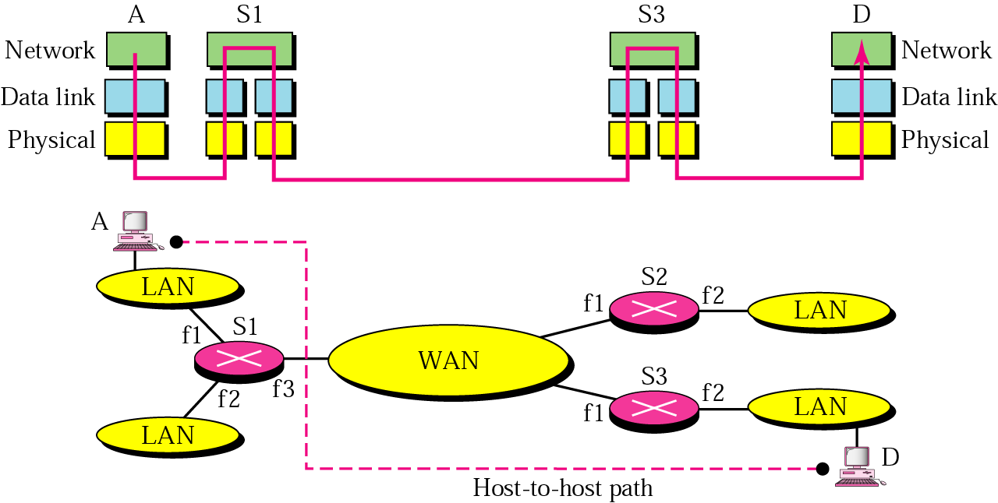
Why the Network Layer
The functions at the network layer enable the router to make that choice.
Carol Davids © 2014

Slide 33
Network layer at source
Receives data packet from layer 4
  Creates the datagram including source IP and destination IP addresses
  Fragments the packet if necessary
Carol Davids © 2014

Slide 34
Network layer at destination
Verifies the address to ensure that the datagram has reached the right host.
Checks for errors and discards if errors are present
Re-assembles fragmented datagrams
Carol Davids © 2014

Slide 35
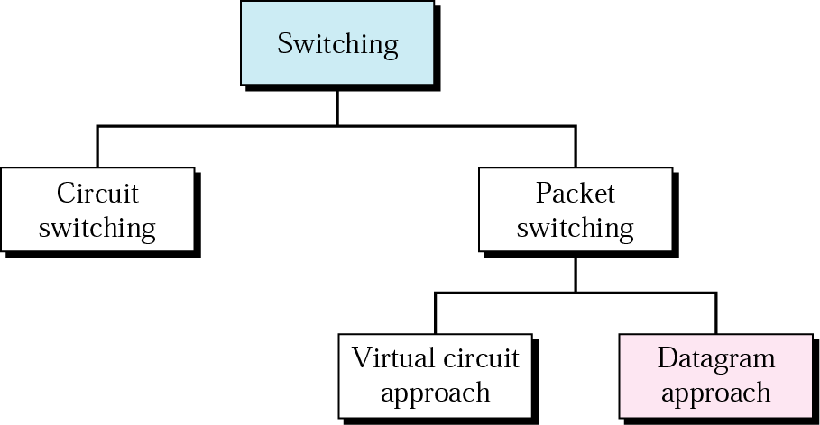
switching
switching implies making a decision as to how to route something - a call or a packet of data for example.
Carol Davids © 2014
Notes:
Routing function layer 3 only
Application layer 5 gateway

Slide 36
Circuit switching
Circuit switching involves a device - switch - that connects circuits - actual loops of wire.
Used in the original telephone network.
Carol Davids © 2014

Slide 37
Packet switching
The Internet at the network layer is a packet-switched network.
Carol Davids © 2014

Slide 38
Packet switching - datagram
Internet uses the datagram approach
This is a connectionless service
Each datagram takes its own path through the network
Carol Davids © 2014

Slide 39
Packet Switching - virtual circuit
In the virtual circuit approach a single route is chosen for all the data packets of the transmission.
Switching decisions are based on a virtual circuit (VC) identifier
The VC identifier is a layer 2 (datalink layer) entity.
Frame Relay and ATM are examples of protocols that are used for this type of switching
Carol Davids © 2014

Slide 40
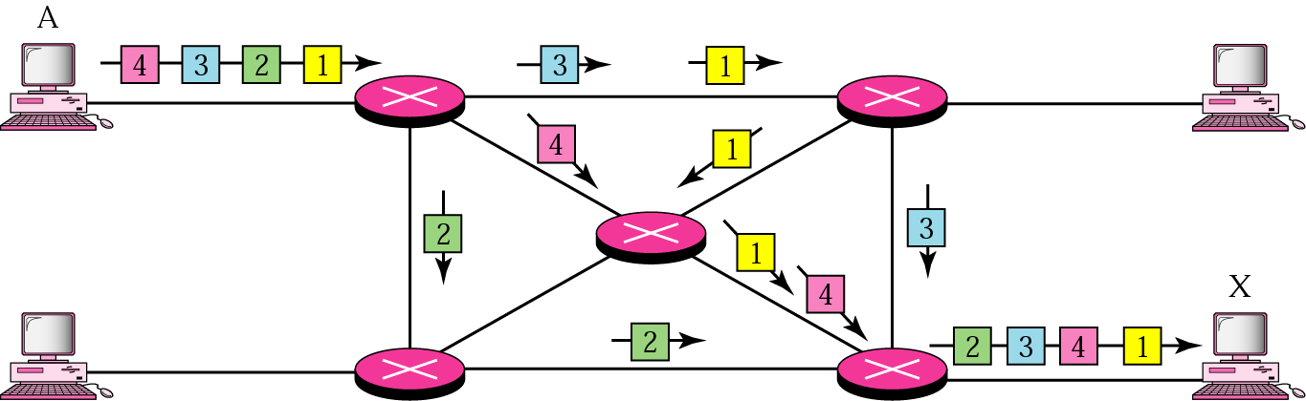
Switching Datagrams
Switching at the network layer on the Internet uses the datagram approach to packet switching
Carol Davids © 2014
Notes:
Classic picture

Slide 41
Packet Switching - Datagram
Packets 1,2,3 and 4 are all part of the same transmission
But they are shown below taking different routes or paths through the network
Carol Davids © 2014

Slide 42
Switching Datagrams
Notice that the 4 datagrams arrive out of sequence in this example
Carol Davids © 2014

Slide 43
Switching Datagrams
At the network layer on the Internet, the communication is connectionless.
Refer back to the IP datagram structure - there is no sequence number there and no connection ID.
Carol Davids © 2014

Slide 44
The End
Carol Davids © 2014

